Slide 1

WELCOME TO DTVS
Purpose of this training is to educate all about
INDUSTRIAL HAZARDS
ACCIDENTS
UNSAFE ACTS & UNSAFE CONDITIONS
YOUR ROLE IN ACCIDENT PREVENTION
INCIDENTS CASE STUDY

Slide 2
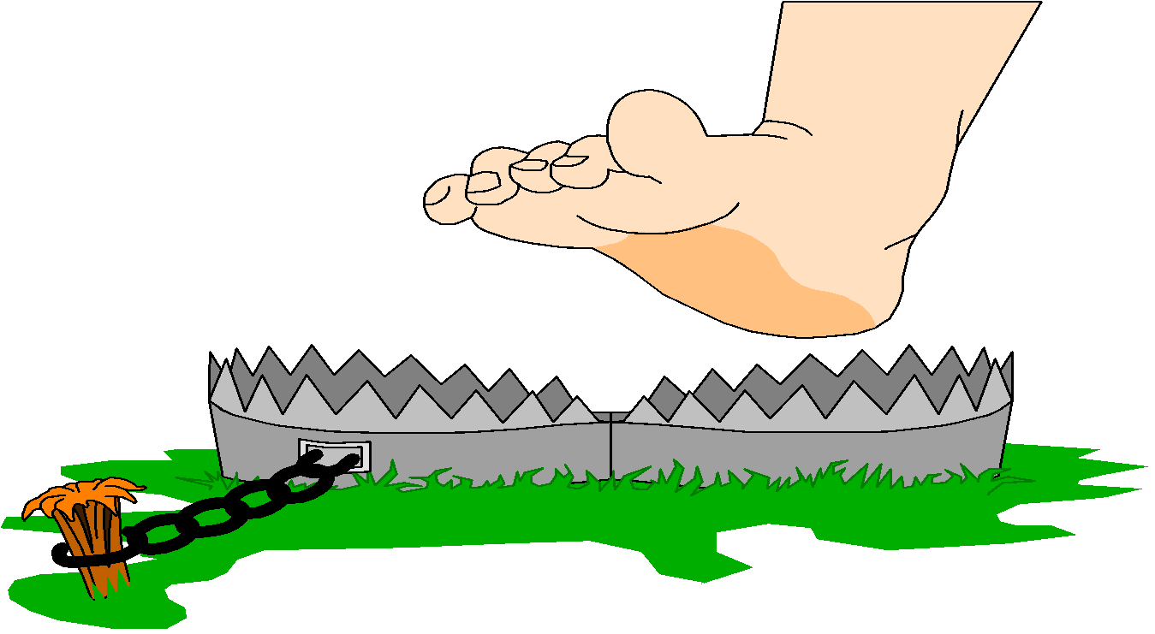
WHAT IS A HAZARD ?
ANYTHING THAT CAN HARM US IS A HAZARD
THERE ARE HAZARDS IN EVERY TRADE THAT IS WHY SAFETY RULES ARE MADE.

Slide 3
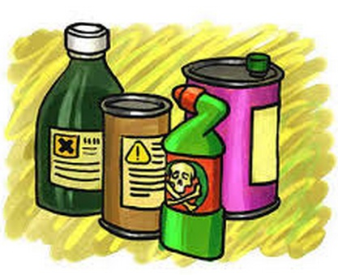
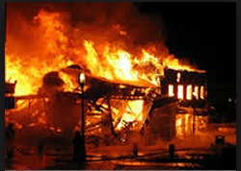
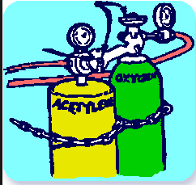
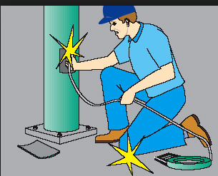
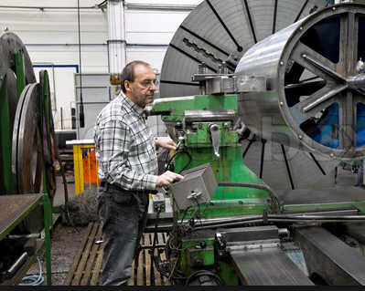
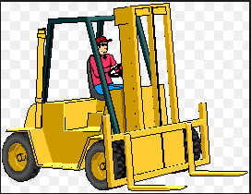
CHEMICALS
FIRE & EXPLOSION
TOXIC GASES
INDUSTRIAL HAZARDS
ELECTRICITY
MACHINERY
MATERIAL HANDLING

Slide 4
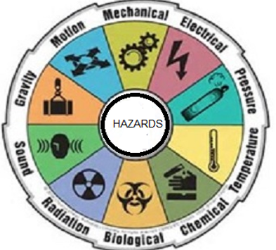
DIFFERENT CATAGORIES OF HAZARDS
HAZARD EXISTS EVERYWHERE

Slide 5
HAZARDS A COMPARISON
Hazards may be same but their harm varies with their Magnitude & Type
HAZARDS AT HOME | INDUSTRIAL HAZARDS
Fire Hazard Low We will have 1 0r 2 LPG cylinders. Handled by all in the family. Will affect the home only. | High Fire Hazard Large quantities of burning materials. Handled by experienced and trained. Will affect the areas outside also.
2. Electricity is low voltage (220V AC ) | 2. Electricity will be to the tune of( 11KV)
3. Machines are less hazardous | 3. Machines are dangerous.
4. Material handling is simple and manual | 4. Material handling is more dangerous. Heavy Machinery are involved in handling.
5. No Gas cylinders of toxic nature | 5. Toxic gases like ammonia may be used.
Hazards cannot be eliminated they can only be controlled

Slide 6
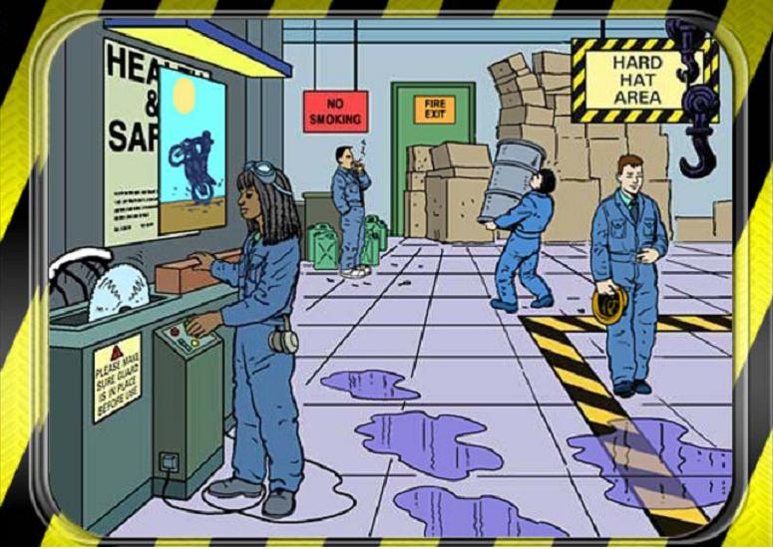
SPOT THE HAZARDS IN THE PICTURE – (Exercise -01)
( There are 8 hidden hazards in the picture below )

Slide 7
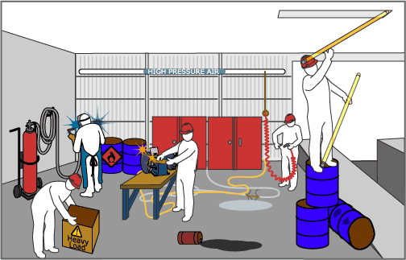
SPOT THE HAZARDS IN THE PICTURE – (Exercise - 02)
( There are 8 hidden hazards in the picture below )

Slide 8
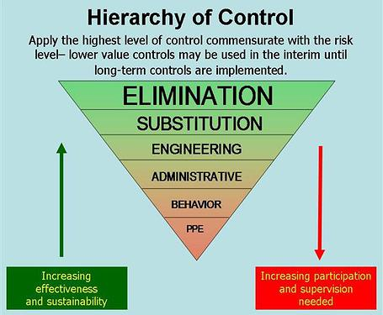

Slide 9

TYPES OF INDUSTRIAL ACCIDENTS AS PER FACTORIES ACT
Our Aim : Zero Accident
FATAL
MAJOR
MINOR
INCIDET
NEAR MISS
ACCIDENTS CAN HAPPEN TO ANY TYPE OF EMPLOYEE, EVEN TO THE EXPERIENCED
Type | Description
1. Near Miss | Possibility of human injury but No Human injury ( Ex: Fan or any component falling to ground)
2. Incident | Return to work within few hour of the accident ( Requires rest and no treatment is required )
3. Minor | Return to work within 48 hours of the accident ( A small cut injury which requires a bandage & rest )
4. Major | Return to work within 21 days of the accident ( Fracture or deep cut injury which requires a surgery )
5. Fatal | Death or Permanent Disablement

Slide 10
HENRICH THEORY OF ACCIDENT
THIS THEORY IS APPLICABLE TO ALL TYPE OF INDUSTRIES BUT NUMBERS INDICATED MAY VARY
Major / Fatal
1
29
Minor
299
Incident
2999
Near Miss
IDENTIFY ACCIDENTS AT THE EARLIER STAGE AND PREVENT MOVING UPWARDS

Slide 11
Why Accidents happen ?
ACCIDENT
UNSAFE CONDITION
UNSAFE ACT
BECAUSE OF SITAUTION
HUMAN ERROR
Un guarded Machines
Wet & Slippery floor
High Noise areas
Poor lighting & Poor Ventilation
No proper Protective Gear (PPE)
Poor house keeping
Damaged electrical cables
Not following Safety rules
Not following operating procedures
Operating un authorized Machines
Bye passing safety systems
Not using proper Protective Gear (PPE)
Disturbing others while working
Playing in the working areas.
Any type of Accident can be Prevented

Slide 12
Loss of Accidents
AFFECTED | DIRECT ( What you can see ) | INDIRECT ( What you cannot see )
EMPLOYEE | Pain of injury. Medical Expenses Loss of Earning | Fear of recovery Fear of Punishment Fear of Job
EMPLOYEE SOCIETY | Interruption in their regular work. Expenses | Son going to work after discontinuing studies. House wife going for work.
EMPLOYER | Medical expenses Replacement of men & repair of Machinery Idle wages to employee | 1. Company reputation affected. Business interruption
EMPLOYER SOCIETY | Production cost Increase. Business of our Supplier / Contractor affected | 1. Customer's business affected. 2. Higher price for products borne by the consumers .

Slide 13
AFTER AN ACCIDENT
PROCESS FLOW OF ACTIONS
ACCIDENT REPORT
ACCIDENT ANALYSIS FOR ROOT CAUSE
REPORT TO GOVT
AUTHORITIES
CAPA / COMPLETE / HORIZONTAL DEPLOYMENT
UPDATE RECORDS COMMUNICATE TO ALL
KEY POINTS TO BE NOTED
ROLES & RESPONSIBILITIES CLEARLY DEFINED
TARGETS FIX ED FOR EACH ACTION PLANNED
PROPER FORMATS FOR CAPTURING DATA
MAINTAIN RECORDS FOR FUTURE ANALYSIS
ACCIDENT PREVENTION IS EVERYBODIES RESPONSIBILITY

